Slide 1
DATA SCIENCE

Slide 2
Stats
Ml
DS
Data science is a multi-disciplinary field that uses scientific methods, processes, algorithms and systems to extract knowledge and insights from structured and unstructured data.
Data science is the same concept as data mining and big data: "use the most powerful hardware, the most powerful programming systems, and the most efficient algorithms to solve problems".
Data science is a "concept to unify statistics, data analysis, machine learning and their related methods" in order to "understand and analyze actual phenomena" with data.
In 2012, when Harvard Business Review called it "The Sexiest Job of the 21st Century",^{[8]} the term "data science" became a buzzword. It is now often used interchangeably with earlier concepts like business analytics,^{[9]} business intelligence, predictive modeling, and statistics

Slide 3
VOLUME
VARIETY
VELOCITY
BIG DATA
BIG
DATA
Data which is too large and Complex
for conventional data tools to capture
store and analysis

Slide 4

Share Traded on US
Market Each day:
7 Billion
Data generated by a
Flight from NY to London.
10 terabyte
No. of Tweets on
Twitter per day:
400 Million
No of like on FB
Each day:
3 Billion
90% of the world data is generated
in last two year.

Slide 5

What is Analytics
Data on its own is useless unless you make some useful decision out of it
Scientific process of transforming data into insight
For making better decision , offer new opportunity
& business intelligence.

Slide 6
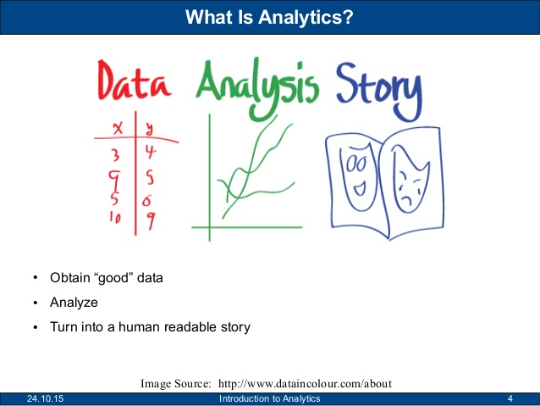

Slide 7
The Case of Business Analytics
Business Need
The business environment today is
Most complex than ever before.
Business are expected to be diligently
Responsible for customer satisfaction
Customer increasing demand for various
Stake holders
Solution
Organization have been
Turning to Analytics.
Survey by IBM about 83%
Of CIOs have singled out
To Business intelligence
And Analytics.
Goals
Major Goals
Max. Profit
Opt. Cost

Slide 8
Enabling Smart Decision
Based on data
“WHAT SHOULD BE DO”
PRESCRIPTIVE ANALYTICS
ANALYTICS
PREDICTIVE ANALYTICS
DESCRIPTIVE ANALYTICS
Based on what has happened
Predict what will going to happen.
Data Mining to provide data
Insight What will happened?

Slide 9



TYPE OF ANALYTICS
“WHY DO AIRLINE PRICE
CHANGE EVERY HOUR”
PRESCRIPTIVE ANALYTICS
“HOW E-COMMERCES COMPANY
KNOW WHAT OFFER TO GIVE YOU”
PREDICTIVE ANALYTICS
“ HOW DID NETFLIX RECOOMEND
YOU JUST THE RIGHT MOVIE”
DESCRIPTIVE ANALYTICS

Slide 10
GROWING NEED OF ANALYTICS
Generation of large amount of data for business transactions
DATA IS GENERATED
DATA VOLUME
DATA HARNESSING
“Company store each
Piece of information
Generated by the
Transaction made
By customer &
Business operation”.
2010
1.2
DATA IS ANALYSED
2012
2.4
2015
7.9
LEARNING FROM THE DATA IS USED IN DECISION
MAKING AND BUSINESS DEVELOPMENT
Volume in Trillion GB

Slide 11
What Is Data ?
DATA IS A SET OF VALUE OF QUALITATIVE OR QUANTITATIVE VARIABLES
QUALITATIVE
QUANTITATIVE
Data is a numeric measure; it capture the
Measure of an attribute.
EX-
Height of student= 5’6”,5’9”,6’0”,8’9”.
Cost= $120, $165, $200
Data is descriptive in nature
It describe an attribute that
Can be observed but not
Measured.
EX-
Flavors of ice-cream
“vanilla”, ”Butterscotch”
Etc.

Slide 12
BASIS OF DATA CATEGORIZATION
TYPE
SIZE
PROCESSING
DATA
SOURCE
FORM

Slide 13
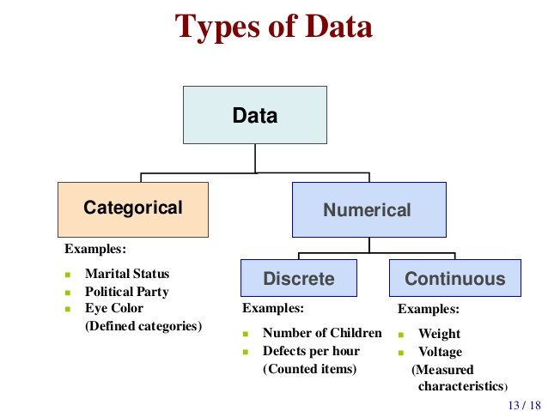

Slide 14
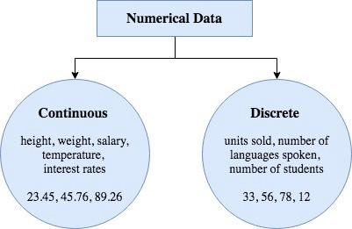

Slide 15

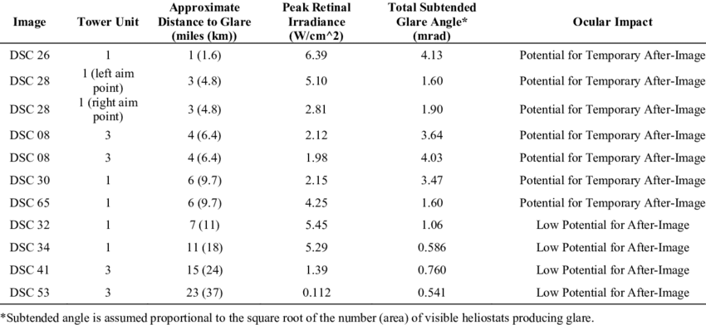
RAW DATA
PROCESS
DATA

Slide 16
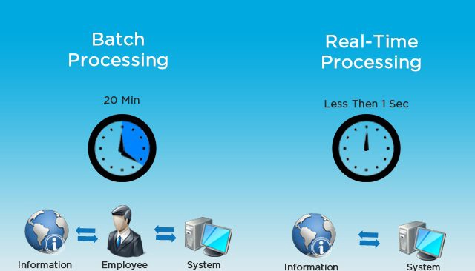
BP VS RTP

Slide 17
DATA
MAIN TYPES
OTHER TYPES
CENSUS
PREDICTION STUDY
STUDIES
OVERTIME
RETROSPECTIVE
OBSERVATIONAL STUDY
CROSS SECTIONAL
CONVENIENCE SAMPLE
LONGITUDINAL
RANDOMIZED TRAIL

Slide 18
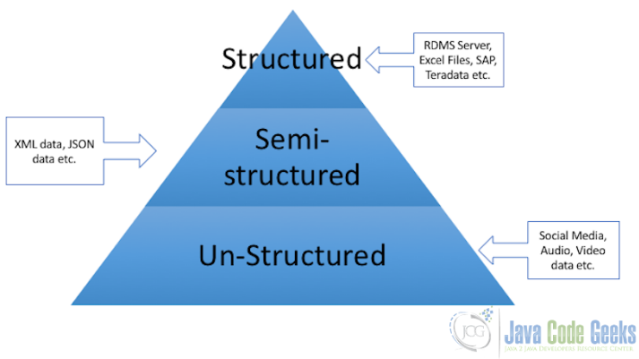

Slide 19
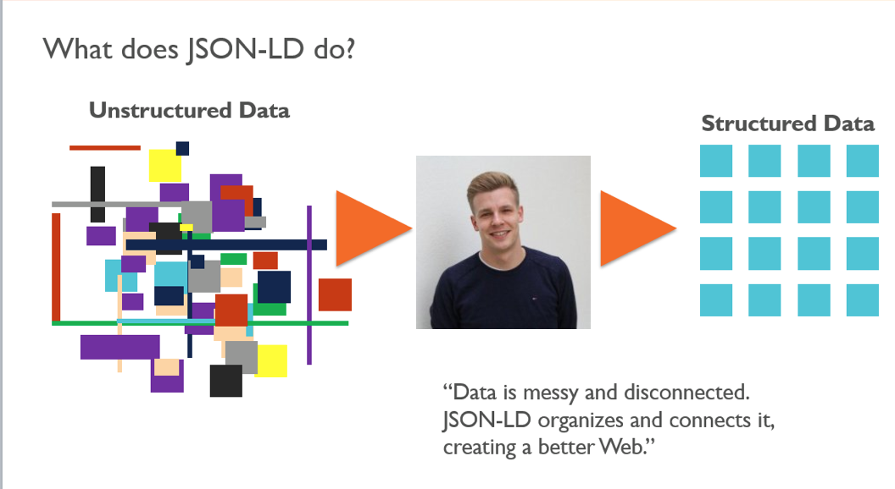

Slide 20
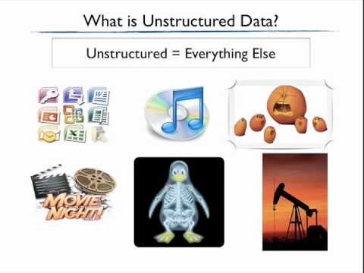

Slide 21
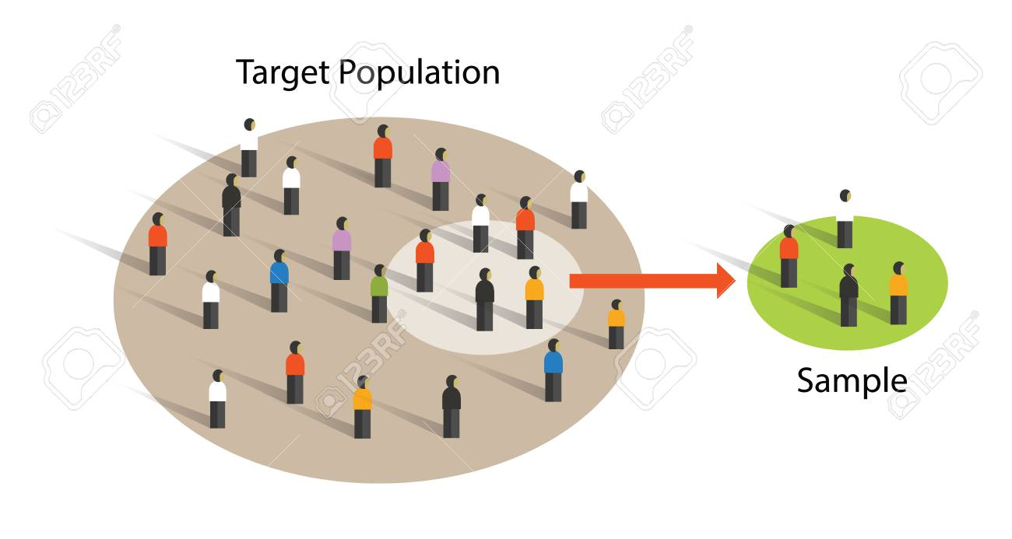

Slide 22
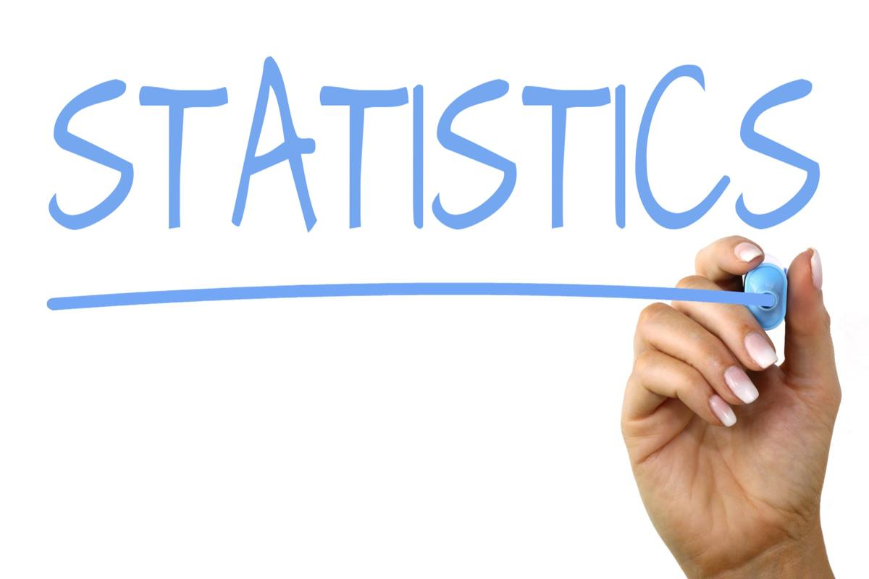

Slide 23
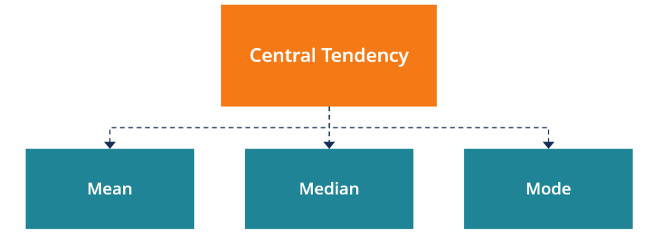

Slide 24
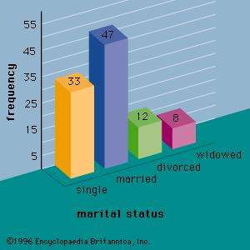
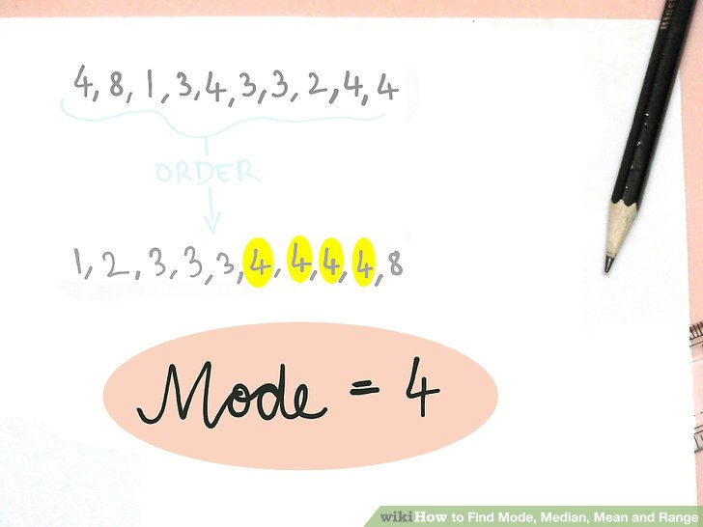
MODE
MOST OCCURRED EVENT OR FREQUENCY
HERE MODE IS 47.

Slide 25
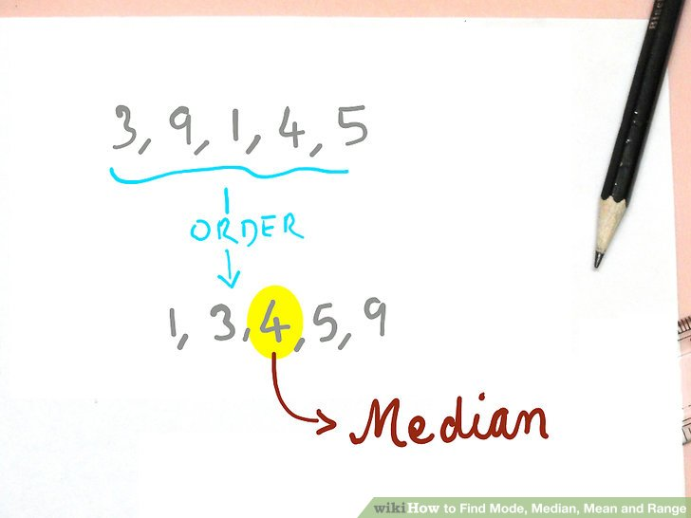
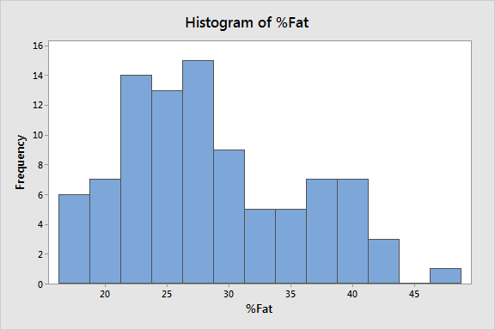
MEDIAN
IT DIVIDE DATA INTO TWO HALF OR WE CAN SAY 50-50.
MEDIAN IS USED WHEN DATA IS NOT NORMALLY DISTRIBUTED.

Slide 26
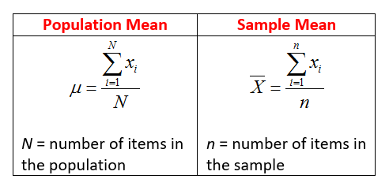
MEAN
DEFINE AS AVERAGE OF NUMBER
X= (X1+X2+X3+X4+X5)/5

Slide 27
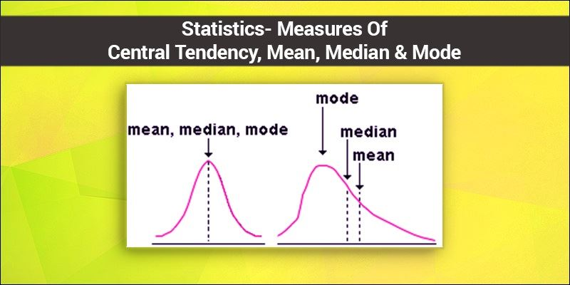

Slide 28
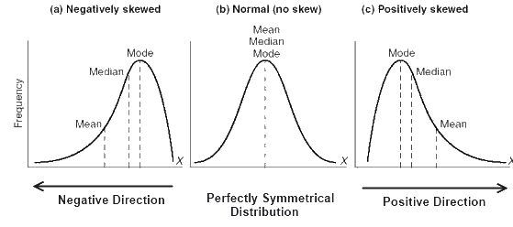

Slide 29
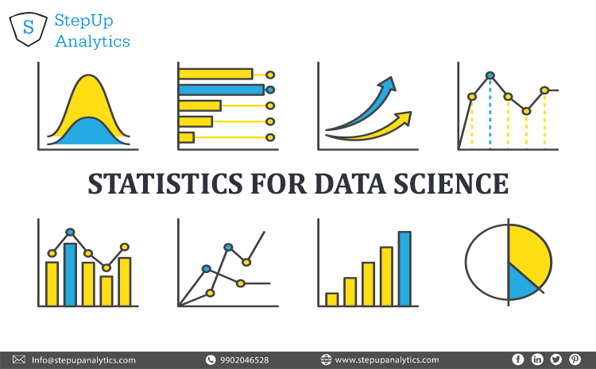

Slide 30
MEASURE OF DISPERSION
SEMI-INTERQUARTILE-RANGE
INTERQUARTILE RANGE REFER TO DISTANCE BETWEEN THE 1ST AND 3RD QUARTILE.
Q1
Q2
Q3
25%
25%
25%
25%
Interquartile Range
Q3-Q1

Slide 31
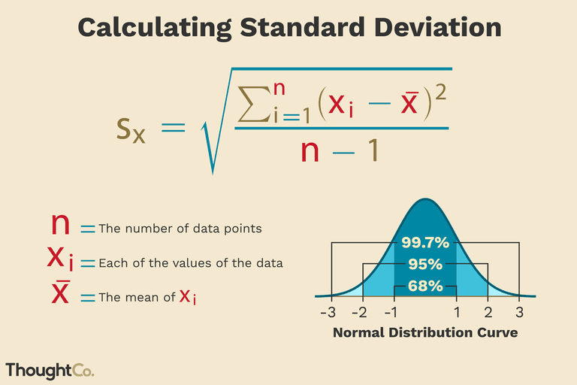

Slide 32
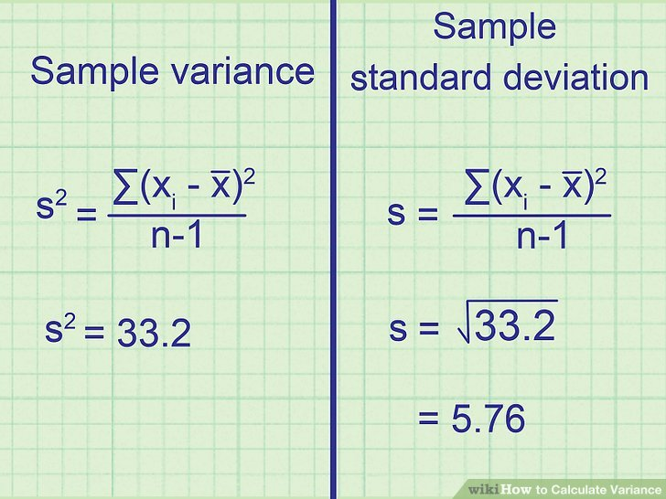

Slide 33
Coefficient of Variation
CV= (S/x”)*100%
S= Standard Deviation
X”= Average or Mean
STOCK A
STOCK B
Avg price last year=$5
Standard Deviation=$5
CV=100%
Avg price last year=$100
Standard Deviation=$5
CV=5%

Slide 34
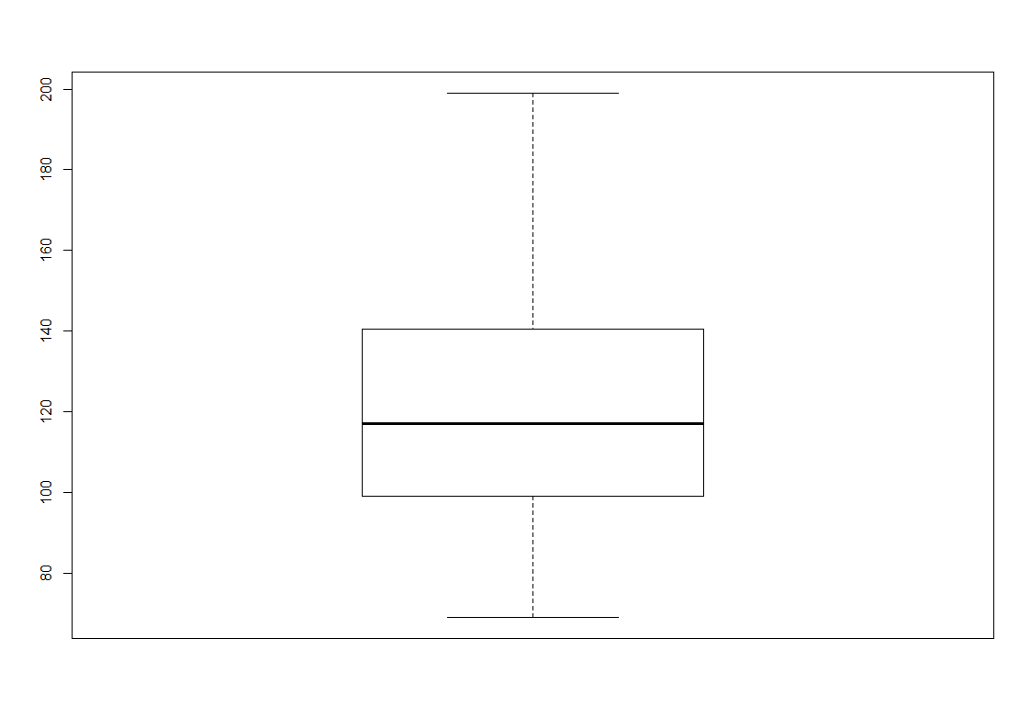
Boxplot
A box-plot is a visual description of the distribution based on
minimum
Maximum
Q1
Median
Q3
Median
Q3
Q1
Maximum
Minimum

Slide 35
Summary measure
CENTRAL TENDENCY
QUARTILE
VARIATION
VARIANCE
COV( COEFF. OF VARIATION)
MEAN
MODE
MEDIAN
RANGE
STANDARD
DEVIATION

Slide 36
ANOVA
ANALYSIS OF VARIANACE
Variation among and between group, use to analyse the difference among group mean in a sample
F= (treatment effect+ chance/error)/(chance/error)
ANOVA is a statistical method for testing weather two or more dependent variable mean are equal.
The probability that any difference in means across several group are due solely to sampling error.
With ANOVA a single metric dependent variable is tested as the outcome of a treatment or manipulation.
Instead of using a mean difference (t test) the variance of the group mean about the grand mean over all group is
Used.

Slide 37
ANOVA
ONE WAY ANOVA
RANDOMIZED BLOCK DESIGN
TWO WAY ANOVA
F-TEST
INTERACTION EFFECTS
TUKEY MULTIPLE COMPARISION
TUKEY KRAMER MULTIPLE COMPARISONS
TUKEY MULTIPLE COMPARSIONS
LEVENE TEST FOR HOMOGENEITY OF VARIANCE

Slide 38
ASSUMPTION
SAMPLES ARE INDEPENDENT
NORMALITY WITHIN EACH GROUP: DEPENDENT VARIABLE IS NORMALLY DISTRIBUTED FOR EACH OF THE SAMPLES.
THE VIOLATION OF THE NORMALITY ASSUMPTION IS NOT A SERIOUS PROBLEMS
EACH VARIANCES
WITHIN GROUP VARIANCE ARE THE SAME FOR EACH OF THE GROUP
BECOMES LESS IMPORTANT IF THE SAMPLE SIZE ARE SIMILAR AMONG THE GROUP.

Slide 39
HYPOTHESIS
H0: The mean for all the group are same (equal).
Ha: The means are different for at least one pair of groups.
H0: µ1=µ2=µ3=‘’’’’’’’’’’’’=µk
Ha: µ1≠µ2 ≠ µ3=‘’’’’’’’’’’’’ ≠ µk

Slide 40
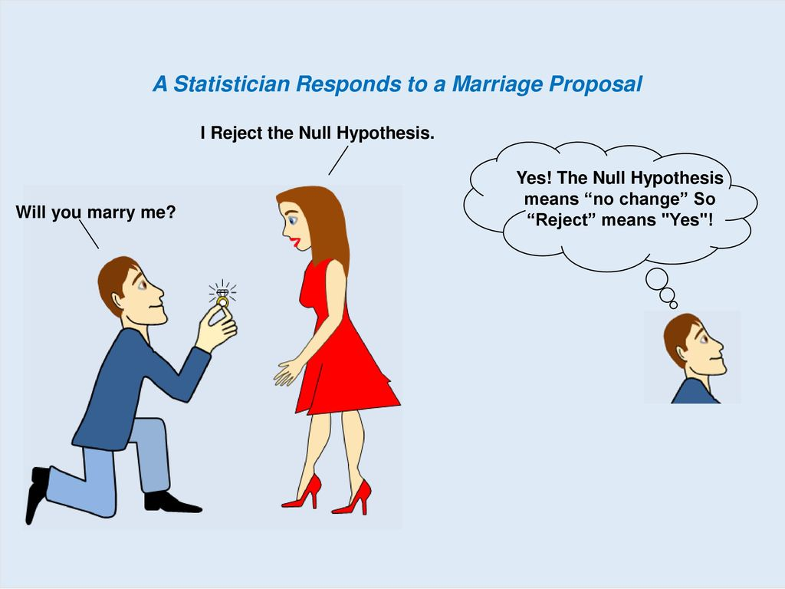
One-Way Anova

Slide 41
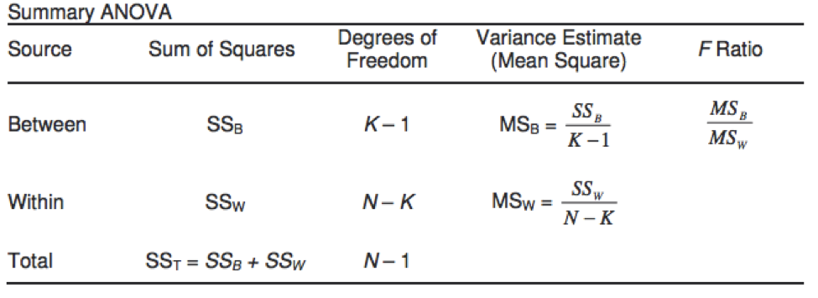

Slide 42
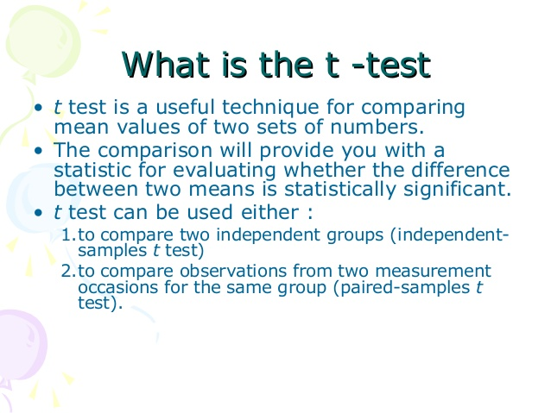

Slide 43
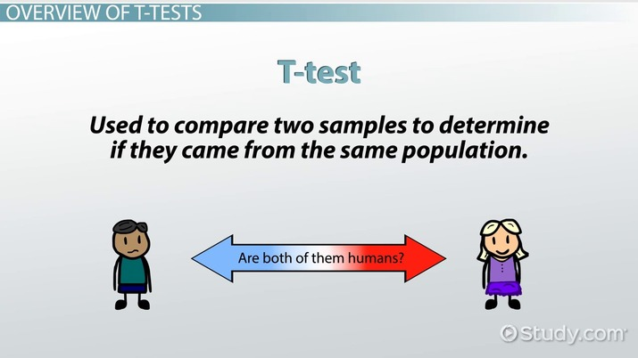

Slide 44
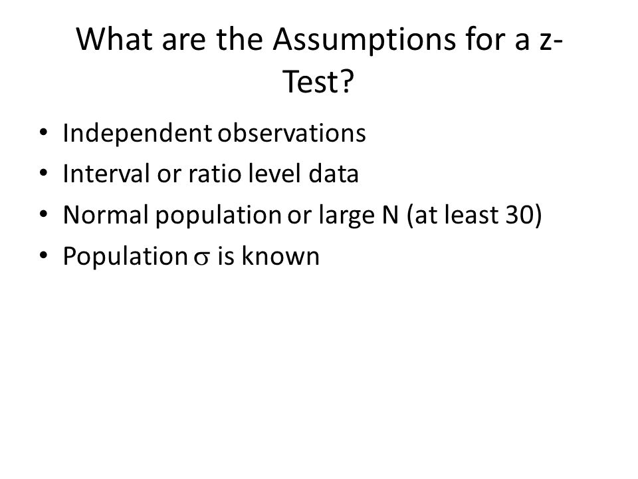

Slide 45
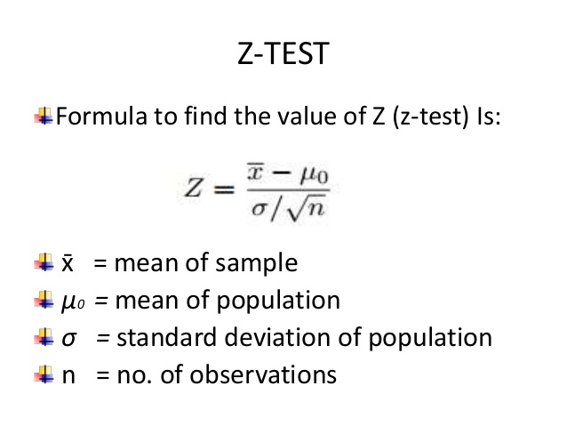

Slide 46
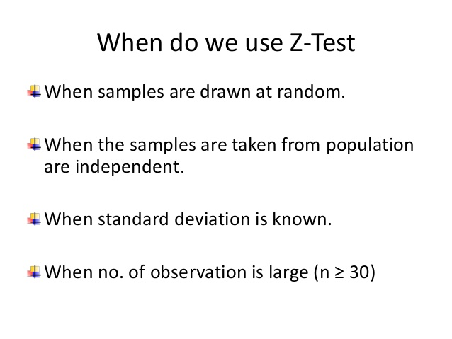

Slide 47
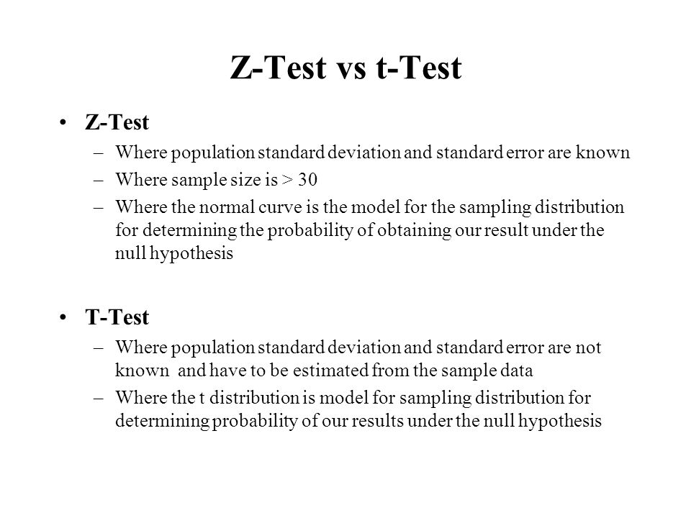

Slide 48
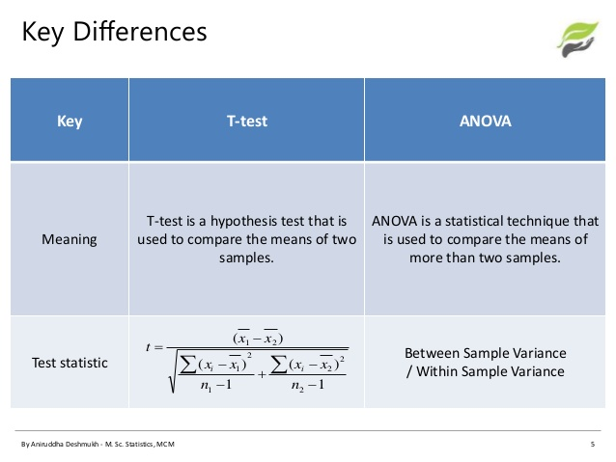

Slide 49
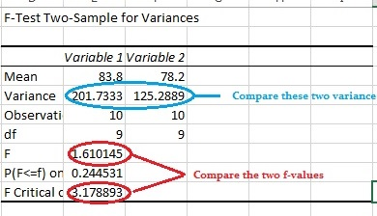

Slide 50
Type of variable
X
Y
Independent
Dependent
Y=mX +error

Slide 52
Z-score
Measure distance of raw scores from the mean
Unit of measure is in standard deviation
Equals 0 at the mean
Negative to the left of the mean
Positive to the right of the mean

Slide 53
Negative Z-Score
+ Z-Score
mean

Slide 54
Prob. of an observation to
Lie between 0 and 1.
68%
34%
1
1
2
3
mean
1 SD

Slide 55
About 47.5% observation lies 1.96 SD from
Mean.
47.5%
Common Z SCORE
1.96
0
1.96
SD

Slide 56
About 47.5% observation lies 1.96 SD from
Mean.
95%
47.5%
Common Z SCORE
47.5
2.5% in each tail
2.5%
1.96
0
1.96
SD

Slide 57
Find Z-score for the following data
Show the mean and the SD of the Z-score of the are 0 and 1 respectively
12 14 16 18 19 23
 |  |  | Z-SCORE=(X-X”)/sigma
12 | -5 | 25 | -1.40
14 | -3 | 9 | -0.84
16 | -1 | 1 | -0.28
18 | 1 | 1 | 0.28
19 | 2 | 4 | 0.56
23 | 6 | 36 | 1.68
X
X-X’’
(X-X’’)(X-X”)
Sum of X=102
N=6
X”=17
Sum of (X-X”)2=Y
Sigma=sqrt(Y/N)
Sigma = 3.56

Slide 58
Mean of Z-score= (-1.40+-0.84+-0.28+0.28+0.56+1.68)/6
(Z-0)2
1.46
0.71
0.08
0.08
0.31
2.82
Sum of all=((Z-0)2)=5.96
Sigma’= Sqrt(5.96/6)
Sigma’=0.9966
We see that SD for Z-score is 1
Mean for Z-score is 0

Slide 59
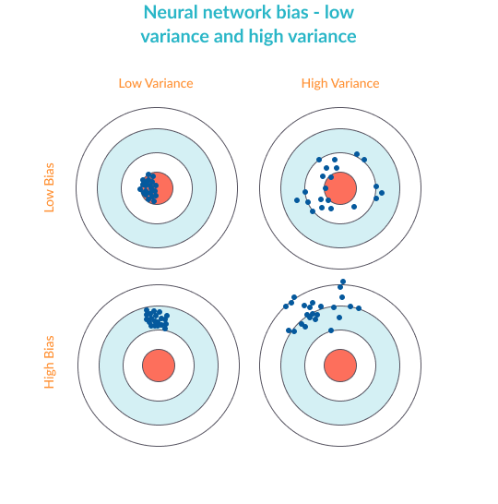
Bias and Variance
When we talk about Underfitting and Over-fitting we came to two terms Bias and Variances
Bias—high bias means the model is not “fitting” well on the training set. This means the training error will be large. Low bias means the model is fitting well, and training error will be low.
Variance—high variance means that the model is not able to make accurate predictions on the validation set. The validation error will be large. Low variance means the model is successful in breaking out of its training data.

Slide 60
OVERFITTING AND UNDERFITTING
To take a real-life example, borrowed from the excellent post by William Koehrsen, overfitting is like trying to learn the English language by using a very specific training set. For example, reading all the plays by Shakespeare. Someone who learns the language using only Shakespeare, as an example, will learn a very specialized form of English and may not be able to understand other English text.
To understand underfitting, consider someone who tries to learn English by listening to Seinfeld episodes, but ignoring most of the sentences and using only those that start with common words like “a”, “the”, “I”, etc. This person would have a very limited understanding even of those sentences themselves, not to mention a poor ability to understand English text in general.

Slide 61
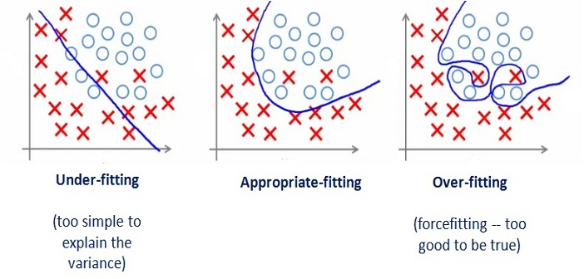

Slide 62

Overfitting happens when the neural network is very good at learning its training set, but cannot generalize beyond the training set (known as the generalization problem).
The Symptoms Of Overfitting Are:
Low Bias Accurate Predictions For The Training Set
High Variance Poor Ability To Generate Predictions For The Validation Set

Slide 63
Underfitting happens when the network is not able to generate accurate predictions on the training set—not to mention the validation set.
The Symptoms Of Underfitting Are:
High Bias Poor Predictions For The Training Set
High Variance Poor Predictions For The Validation Set

Slide 64
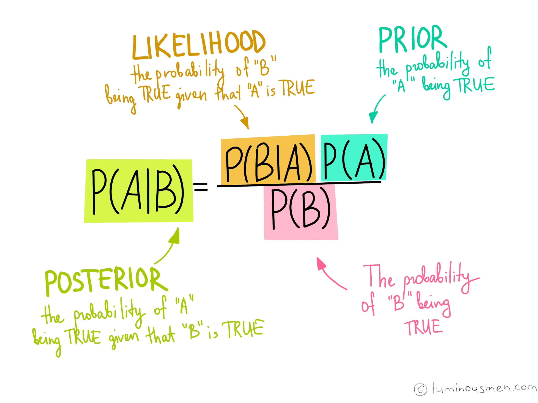

Slide 65
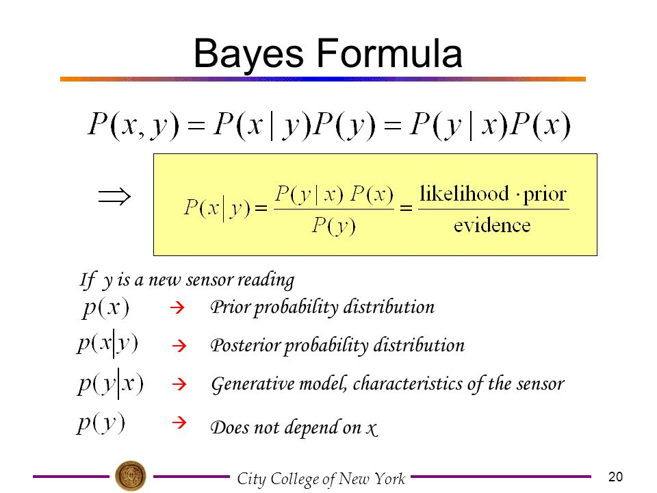

Slide 66
BADMINTON PLAY DATA
DAY | OUTLOOK | TEMP | HUMIDITY | WIND | PLAY
1 | SUNNY | HOT | HIGH | WEAK | NO
2 | SUNNY | HOT | HIGH | STRONG | NO
3 | OVERCAST | HOT | HIGH | WEAK | YES
4 | RAIN | MILD | HIGH | WEAK | YES
5 | RAIN | COOL | NORMAL | WEAK | YES
6 | RAIN | COOL | NORMAL | STRONG | NO
7 | OVERCAST | COOL | NORMAL | STRONG | YES
8 | SUNNY | MILD | HIGH | WEAK | NO
9 | SUNNY | COOL | NORMAL | WEAK | YES
10 | RAIN | MILD | NORMAL | WEAK | YES
11 | SUNNY | MILD | NORMAL | STRONG | YES
12 | OVERCAST | MILD | HIGH | STRONG | YES
13 | OVERCAST | HOT | NORMAL | WEAK | YES
14 | RAIN | MILD | HIGH | STRONG | NO

Slide 67
THE MODEL TRAINING PHASE
DAY | OUTLOOK | TEMP | HUMIDITY | WIND | PLAY
1 | SUNNY | HOT | HIGH | WEAK | NO
2 | SUNNY | HOT | HIGH | STRONG | NO
3 | OVERCAST | HOT | HIGH | WEAK | YES
4 | RAIN | MILD | HIGH | WEAK | YES
5 | RAIN | COOL | NORMAL | WEAK | YES
6 | RAIN | COOL | NORMAL | STRONG | NO
7 | OVERCAST | COOL | NORMAL | STRONG | YES
8 | SUNNY | MILD | HIGH | WEAK | NO
9 | SUNNY | COOL | NORMAL | WEAK | YES
10 | RAIN | MILD | NORMAL | WEAK | YES
11 | SUNNY | MILD | NORMAL | STRONG | YES
12 | OVERCAST | MILD | HIGH | STRONG | YES
13 | OVERCAST | HOT | NORMAL | WEAK | YES
14 | RAIN | MILD | HIGH | STRONG | NO
P(PLAY=NO)=5/14
P(PLAY=YES)=9/14

Slide 68
Learning Phase
OUTLOOK | PLAY = YES | PLAY = NO
SUNNY | 2/9 | 3/5
OVERCAST | 4/9 | 0/5
RAIN | 3/9 | 2/5
TEMP | YES | NO
HOT | 2/9 | 2/5
MILD | 4/9 | 2/5
COOL | 3/9 | 1/5
HUMIDITY | YES | NO
HIGH | 3/9 | 4/5
NORMAL | 6/9 | 1/5

Slide 69
WIND | YES | NO
STRONG | 3/9 | 3/5
WEAK | 6/9 | 2/5
TEST PHASE
TEST PHASE
----GIVEN A NEW INSTANCE PREDICT ITS LABEL
X’=(OUTLOOK=SUNNY, TEMP=COOL, HUMIDITY= HIGH, WIND= STRONG
LOOK UP TABLES ACHIEVED IN THE LEARNING PHASE

Slide 70
YES PLAY
P(OUTLOOK=SUNNY|PLAY=YES)=2/9 | P(OUTLOOK=SUNNY|PLAY=NO)=3/5
P(TEMP=COOL|PLAY=YES)=3/9 | P(TEMP=COOL|PLAY=NO)=1/5
P(HUMIDITY=HIGH|PLAY=YES)=3/9 | P(HUMIDITY=HIGH|PLAY=NO)=4/5
P(WIND=STRONG|PLAY=YES)=3/9 | P(WIND=STRONG|PLAY=NO)=3/5
P(PLAY=YES)=9/14 | P(PLAY=NO)=5/14
TEST PHASE
GIVEN INSTANCE PREDICT THE CONDITION
DECISION MAKING WITH THE MAP RULE

Slide 71
P(YES|X’)=[P(SUNNY|YES)P(COOL|YES)P(HIGH|YES)P(STRONG|YES)] P(PLAY=YES)
P(YES|X’)= (2/9)*(3/9)*(3/9)*(3/9)*(9/14)
P(YES|X’) =0.0053
P(NO|X’)=[P(SUNNY|NO)P(COOL|NO)P(HIGH|NO)P(STRONG|NO)] P(PLAY=NO)
P(NO|X’)= (3/5)*(1/5)*(4/5)*(3/5)*(5/14)
P(NO|X’) =0.0206
P(|X’)=[P(SUNNY)P(COOL)P(HIGH)P(STRONG)])=(5/14*4/14*7/14*6/14)=0.021865
P(yes)=0.0053/0.021865= 0.2424=24%
N(no)=0.0206/0.021865=0.9421=94%
We say our final outcome is NO

Slide 72
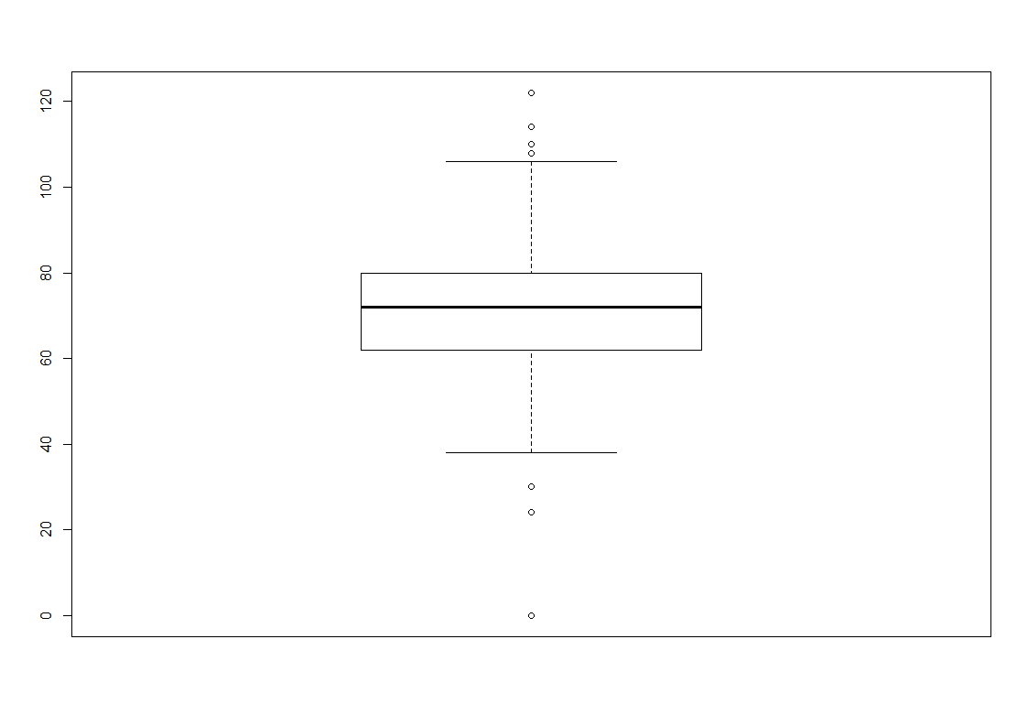

Analysis of variable
Uni-variate
Bi-variate
Uni-variate
Blood-Pressure

Slide 73
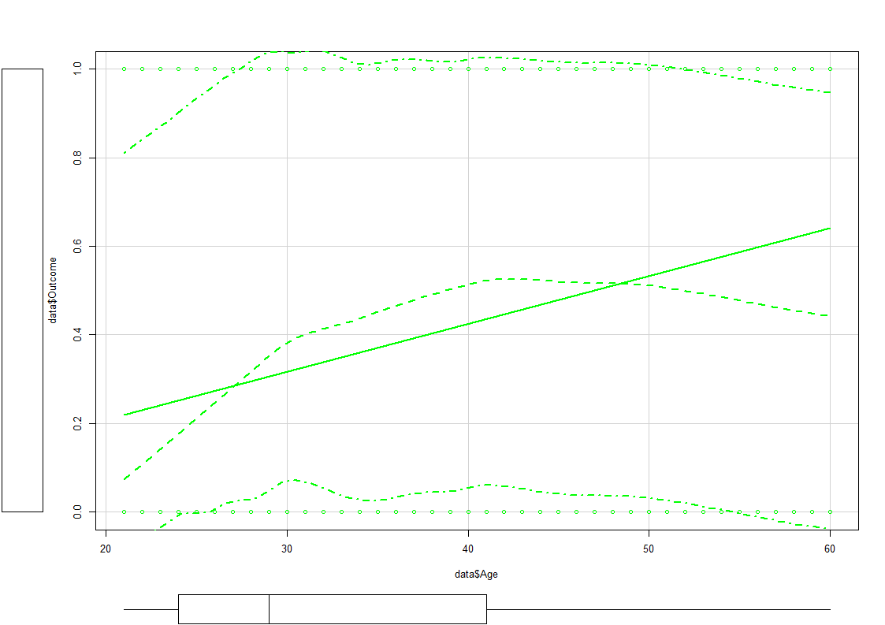
Bi-variate

Slide 74

ML---LIBRARIES
TOP 5 PACKAGES THAT ONE SHOULD KNOW ABOUT
SCIPY
NUMPY
MATPLOTLIB
PANDAS
SEABORN
SCIKIT-LEARN

Slide 75
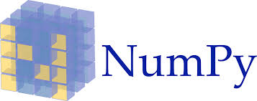
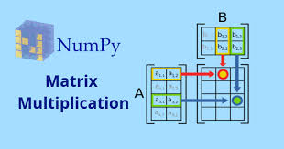
NumPy- Numerical Python
It is the foundational packages for
scientific computing in python
The majority of the module will be based
On Numpy and libraries built on top of Numpy

Slide 76
Also Provide
A fast and Efficient multidimensional array object ndarray
Function for performing element wise computing and maths operation between array
Tools for reading and writing array based on dataset to disk
Ndarray, a fast and space-efficient multidimensional array.
Standard mathematical function for fast operation on entire
array of data Without having to write loops

Slide 77
Useful for
Fast Vectorized array operation for data munging and cleaning subsetting and filtering, transformation any kind of computation
Common array algo like sorting unique set opeartions
Efficient descriptive statistics and aggregating/summarizing data

Slide 78
Creating a simple array: we will use the standard convention of always using :
Import numpy as np
Creating Ndarray
#import the library
Import numpy as np
# define a list
data1=[[1,2,3],[4,5,6]]
#Create an array from the list
arr1=np.array(data1)
# find the Dimensionality of the array
arr1.ndim
# find Shape of the array
arr1.shape
# the data type that array holds
arr1.dtype
# Create a array of Zeroes
>np.zeros((3,6))
Array([[0,0,0,0,0,0],
[0,0,0,0,0,0],
[0,0,0,0,0,0]])
# an array of first 15 number
Np.arange(15).reshape(3,5)
>array([[0,1,2,3,4],
[5,6,7,8,9],
[10,11,12,13,14]])

Slide 79
Arr2d=np.array([[1,2,3],[4,5,6],[7,8,9]])
>arr2d
Question
Select the 3rd row
Arr2d[2]
>>array([7,8,9])
2) arr2d[0][2]
>>3
3)arr2d[0,2]
>>3
### SELECT TILL 3RD ROW
Arr2d[:2]
>>array([1,2,3],[4,5,6])
### selecting the 3rd row
arr2d[2:]
array([[7,8,9]])
# Import the library
Import numpy as np
>Arr=np.arange(10)
>Arr[5]
>Arr[5:8]
>Arr
# an array of first 15 number
Np.arange(15).reshape(3,5)
>array([[0,1,2,3,4],
[5,6,7,8,9],
[10,11,12,13,14]])
>Arr[0,0]
>Arr[0,2]

Slide 80
import numpy as np
a=np.array([[1,2,3],[4,5,6],[7,8,9]])
a
>Out[1]:
array([[1, 2, 3],
[4, 5, 6],
[7, 8, 9]])
>a[2]
Out[2]: array([7, 8, 9])
>a[0][2]
Out[3]: 3
>a[:2]
Out[4]:
array([[1, 2, 3],
[4, 5, 6]])
>a[2:]
Out[5]: array([[7, 8, 9]])
>>a[:,0:2]
Out[6]: array([[1, 2],
[4, 5],
[7, 8]])
>>a[:,0]
Out[7]: array([1, 4, 7])
>>a[0:2,0:2]
Out[8]:
array([[1, 2],
[4, 5]])

Slide 81
a=np.arange(15).reshape((3,5))
a
Out[9]:
array([[ 0, 1, 2, 3, 4],
[ 5, 6, 7, 8, 9],
[10, 11, 12, 13, 14]])
# transpose
a.T
Out[10]:
array([[ 0, 5, 10],
[ 1, 6, 11],
[ 2, 7, 12],
[ 3, 8, 13],
[ 4, 9, 14]])
# Dot product
a=np.random.randn(6,3)
a
Out[12]:
array([[-0.79760652, 0.35813012, 0.07309406],
[-0.54156394, -1.62013043, 0.52258758],
[-0.16155863, -0.29809313, 0.14489533],
[-0.34062047, 0.40302556, 0.29106406],
[ 0.01625327, 0.27105381, 1.56064963],
[-0.23291368, 0.02005108, 0.62607184]])
a=np.random.randn(6,3)
a
np.dot(a.T,a)
Out[13]:
array([[1.81712976, 0.53111879, 0.0822889 ],
[0.53111879, 3.54966642, 2.86040658],
[0.0822889 , 2.86040658, 5.89028338]])

Slide 82
############## UNIVERSAL FUNCTION ##############################
b=np.arange(10)
b
Out[14]: array([0, 1, 2, 3, 4, 5, 6, 7, 8, 9])
np.sqrt(b)
Out[15]:
array([0. , 1. , 1.41421356, 1.73205081, 2. ,
2.23606798, 2.44948974, 2.64575131, 2.82842712, 3. ])
np.exp(b)
Out[16]:
array([1.00000000e+00, 2.71828183e+00, 7.38905610e+00, 2.00855369e+01,
5.45981500e+01, 1.48413159e+02, 4.03428793e+02, 1.09663316e+03,
2.98095799e+03, 8.10308393e+03])

Slide 83
###############BINARY UNIVERSAL OPERATOR########################
X1=[4,2,3]
X2=[2,1,6]
np.greater_equal(X1,X2)
np.greater_equal(X1,X2,dtype=bool)
>>>>>>>Out[19]: array([ True, True, False])
np.mod(X1,X2)
Out[20]: array([0, 0, 3], dtype=int32)

Slide 84
Mathematical and statistical function
c=np.array([[0,1,2],[3,4,5],[6,7,8]])
c.mean()
Out[23]: 4.0
c.sum()
Out[24]: 36
c.std()
Out[25]: 2.581988897471611

Slide 85
QUESTION OF THE DAY
#######
>>>>>>>>a=np.arange(15).reshape((3,5))
>>>>>>>>b=np.arange(15).reshape((5,3))
>>>>>>>>np.concatenate([a,b])
OUTPUT>>><<<<ERROR>>>>>>>>
Traceback (most recent call last):
File "<ipython-input-31-a29a21a55c88>", line 3, in <module>
np.concatenate([a,b])
ValueError: all the input array dimensions except for the concatenation axis must match exactly

Slide 86


PANDAS
IT IS ONE OF THE CRITICAL INGREDIENTS
ENABLING PYTHON TO BE A POWERFUL
AND PRODUCTIVE DATA ANALYSIS ENVIRONMENT
PROVIDE RICH DATA STRUCTURE AND
FUNCTIONS DESIGN TO MAKE WORKING WITH
STRUCTURE DATA SET FAST EASY AND EXPRESSIVE

Slide 87

ESSENTIAL PYTHON LIBRARIES
THE PRIMARY OBJECTIVE IS THAT WE WILL USE DATA FRAME i.e.
A TWO DIMENSIONAL TABULAR, COLUMN –ORIENTED DATA STRUCTURE
WITH BOTH ROW AND COLUMN.
COMBINE HIGH PERFORMANCE ARRAY COMPUTING
FEATURE OF NUMPY WITH FLEXIBLE DATA MANIPULATION
CAPABILITIES OF SPREADSHEETS(SUCH AS SQL)
AT LAST ALL DATA RESHAPE, SLICE AND OPERATION

Slide 88
Data Type in pandas
PANDAS
DATA FRAME
SERIES
PANEL
2D DATA
1D DATA
3D DATA

Slide 89
data.describe()
Out[5]:
account length ... Churn
count 1667.000000 ... 1667.000000
mean 98.646671 ... 0.134373
std 39.400755 ... 0.341155
min 1.000000 ... 0.000000
25% 72.000000 ... 0.000000
50% 98.000000 ... 0.000000
75% 126.000000 ... 0.000000
max 238.000000 ... 1.000000
[8 rows x 19 columns]
data.head()
Out[6]:
state account length ... number customer service calls Churn
0 HI 101 ... 3 0
1 MT 137 ... 0 0
2 OH 103 ... 1 0
3 NM 99 ... 1 0
4 SC 108 ... 2 0
[5 rows x 21 columns]
data.shape
Out[8]: (1667, 21)

Slide 90
data.head()
Out[6]:
state account length ... number customer service calls Churn
0 HI 101 ... 3 0
1 MT 137 ... 0 0
2 OH 103 ... 1 0
3 NM 99 ... 1 0
4 SC 108 ... 2 0
[5 rows x 21 columns]
data.info()
<class 'pandas.core.frame.DataFrame'>
RangeIndex: 1667 entries, 0 to 1666
Data columns (total 21 columns):
state 1667 non-null object
account length 1667 non-null int64
area code 1667 non-null int64
phone number 1667 non-null object
international plan 1667 non-null int64
voice mail plan 1667 non-null int64
number vmail messages 1667 non-null int64
total day minutes 1667 non-null float64
total day calls 1667 non-null int64
total day charge 1667 non-null float64
total eve minutes 1667 non-null float64
total eve calls 1667 non-null int64
total eve charge 1667 non-null float64
total night minutes 1667 non-null float64
total night calls 1667 non-null int64
total night charge 1667 non-null float64
total intl minutes 1667 non-null float64
total intl calls 1667 non-null int64
total intl charge 1667 non-null float64
number customer service calls 1667 non-null int64
Churn 1667 non-null int64
dtypes: float64(8), int64(11), object(2)
memory usage: 273.6+ KB

Slide 91

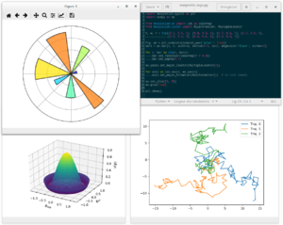
ESSENTIAL PYTHON LIBRARIES
MATPLOTLIB
MOST POPULAR LIBRARY FOR PRODUCING PLOT AND OTHER 2D DATA
VISUALIZATIONS

Slide 92
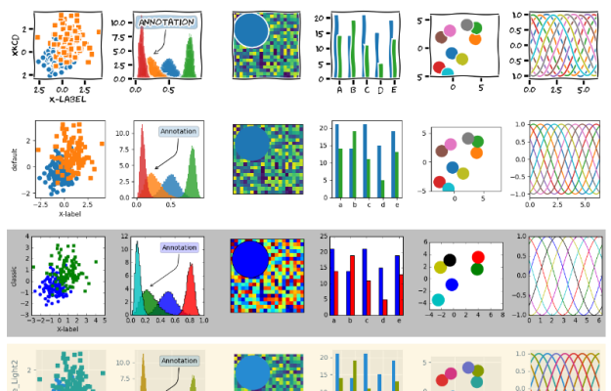

Slide 93

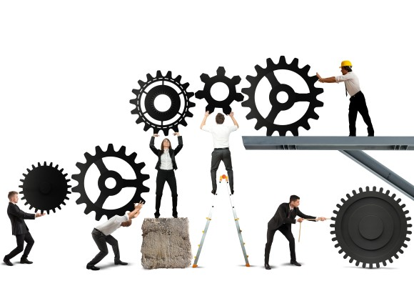
ESSENTIAL PYTHON LIBRARIES
SCIPY
SCIPY – IS A COLLECTION OF PACKAGES ADDRESSING A NUMBER
OF DIFFERENT STANDARD PROBLEM

Slide 94

ESSENTIAL PYTHON LIBRARIES
SKLEARN
ALSO CALLED
‘’Scikit-learn’’
Provide machine learning
Capabilites in python
Open source tools for data mining and data analysis

Slide 95
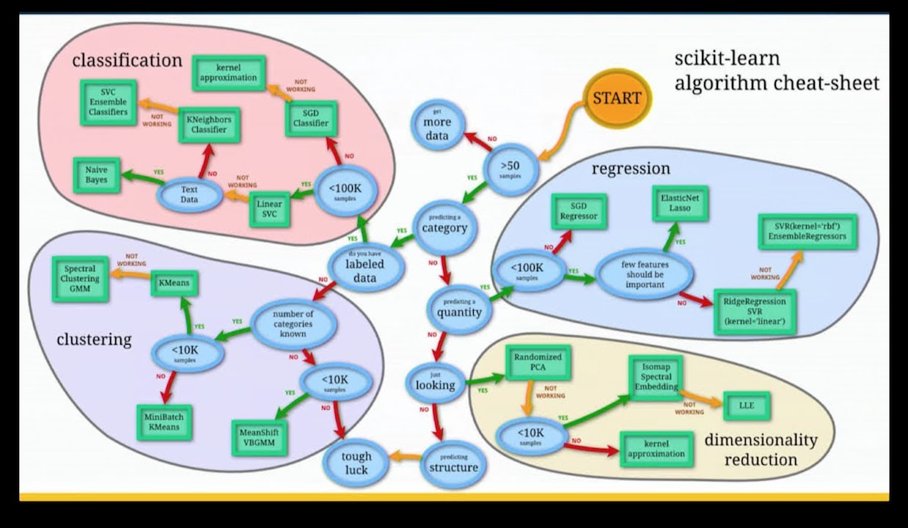

Slide 96
COMPONENTS OF SCIKIT LEARNING
SUPERVISED LEARNING ALGORITHMS
CROSS VALIDATION
UNSUPERVISED LEARNING ALGORITHMS
VARIOUS TOY DATASETS
FEATURE EXTRACTION

Slide 97
SKLEARN LIBRARY
from sklearn import preprocessing
from sklearn.preprocessing import MinMaxScaler
from sklearn.model_selection import train_test_split
from sklearn.linear_model import LogisticRegression
from sklearn.metrics import accuracy_score
#from sklearn.tree import DecisionTreeClassifiers
#from sklearn.ensemble import RandomForestClassifier
#from sklearn.metrics import cohen_kappa_score as kappa
from sklearn.metrics import confusion_matrix
from sklearn import metrics
import matplotlib.pyplot as plt
import warnings
warnings.filterwarnings("ignore")

Slide 98
OVERFITTING AND UNDERFITTING
To take a real-life example, borrowed from the excellent post by William Koehrsen, overfitting is like trying to learn the English language by using a very specific training set. For example, reading all the plays by Shakespeare. Someone who learns the language using only Shakespeare, as an example, will learn a very specialized form of English and may not be able to understand other English text.
To understand underfitting, consider someone who tries to learn English by listening to Seinfeld episodes, but ignoring most of the sentences and using only those that start with common words like “a”, “the”, “I”, etc. This person would have a very limited understanding even of those sentences themselves, not to mention a poor ability to understand English text in general.

Slide 100
Overfitting happens when the neural network is very good at learning its training set, but cannot generalize beyond the training set (known as the generalization problem).
The Symptoms Of Overfitting Are:
Low Bias Accurate Predictions For The Training Set
High Variance Poor Ability To Generate Predictions For The Validation Set

Slide 101
Underfitting happens when the network is not able to generate accurate predictions on the training set—not to mention the validation set.
The Symptoms Of Underfitting Are:
High Bias Poor Predictions For The Training Set
High Variance Poor Predictions For The Validation Set

Slide 102
Confusion matrix for Dieases Model
Confusion Matrix and Statistics
Reference
Prediction 0 1
0 479 118
1 50 232
Accuracy : 0.8089
95% CI : (0.7813, 0.8344)
No Information Rate : 0.6018
P-Value [Acc > NIR] : < 2.2e-16
Kappa : 0.5877
Mcnemar's Test P-Value : 2.351e-07
Sensitivity : 0.6629
Specificity : 0.9055
Pos Pred Value : 0.8227
Neg Pred Value : 0.8023
Prevalence : 0.3982
Detection Rate : 0.2639
Detection Prevalence : 0.3208
Balanced Accuracy : 0.7842
'Positive' Class : 1

Slide 103
Accuracy:
Define as the ratio of (TP+TN)/(TP+TN+FP+FN)
Type 2 error
No heart disease
heart disease
 | 0 Actual value 1
Prediction value 0 1 | 45
No heart disease
479 TN
118 FN
heart disease
50 FP
232 TP
Type 1 error
Accuracy tells us that 80.89% of the people with heart disease and without heart disease were correctly identified by the logistic Regression Model .
S=(TP)/(TP+FN)
S=(232+479)/(232+479+50+118)
S=80.89%

Slide 104
SENSTIVITY
It is define as the ratio of (Total True Positive)/(True Positive+False Negative)
No heart disease
heart disease
 | 0 Actual value 1
Prediction value 0 1 | 45
No heart disease
479 TN
118 FN
heart disease
50 FP
232 TP
Senstivity tells us that 66.29% of the people with heart disease were correctly identified by the logistic Regression Model .
S=(TP)/(TP+FN)
S=232/(232+118)
S=62.29%

Slide 105
SPECIFICITY
It is define as the ratio of (Total True Negative)/(True Negative + False Positive)
No heart disease
heart disease
 | 0 Actual value 1
Prediction value 0 1 | 45
No heart disease
479 TN
118 FN
heart disease
50 FP
232 TP
Specificity tells us that 90.05% of the people without heart disease were correctly identified by the logistic Regression Model .
S=(TN)/(TN+FP)
S=479/(479+50)
S=90.05%

Slide 106
PREVALENCE
It is define as the ratio of (TP+FN)/(TP+TN+FP+FN)
No heart disease
heart disease
 | 0 Actual value 1
Prediction value 0 1 | 45
No heart disease
479 TN
118 FN
heart disease
50 FP
232 TP
Specificity tells us that 39.82% of the people have Response to the model correctly identified by the logistic Regression Model .
S=(TP+FN)/(TN+FP+TP+FN)
S=350/(879)
S=39.82%

Slide 107
Recall:
It is define as the ratio of TP/(TP+FN)
It calculates how many of the athe actual+ our model capture through lable as positive.
No heart disease
heart disease
 | 0 Actual value 1
Prediction value 0 1 | 45
No heart disease
479 TN
118 FN
heart disease
50 FP
232 TP
R=(TP)/(TP+FN)
R=232/(232+118)
R=62.29%

Slide 108
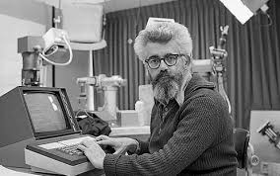
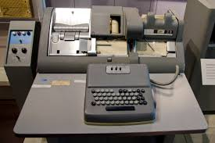

Response
Response
Response
Not response

Slide 109
Precision:
It is define as the ratio of TP/(TP+FP)
It talk abut how precise or accurate ur model is out of those predicted positive how many are act+.
No heart disease
heart disease
 | 0 Actual value 1
Prediction value 0 1 | 45
No heart disease
479 TN
118 FN
heart disease
50 FP
232 TP
P=(TP)/(TP+FP)
P=232/(232+50)
P=82.26%

Slide 110
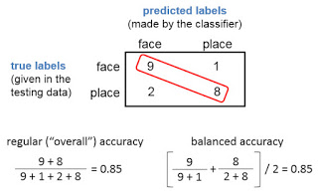
BALANCED ACCURACY
I was a bit thrown at OHBM by mentions of using "balanced" accuracy to describe classification performance ... what's wrong with "regular" accuracy? Well, nothing is wrong with "regular" accuracy, if your dataset is already balanced (meaning equal numbers of trials in each class and cross-validation fold, which I very highly recommend). But if your test set is not balanced, "balanced" accuracy is probably better than "regular".
At left is an example of a confusion matrix produced by a classifier, where the test set was balanced, with 10 examples of class face, and 10 of class place. The classifier did quite well: 9 of the 10 face examples were (correctly) labeled face, and 8 of the 10 place examples were (correctly) labeled place. For lack of a better term, what I'll call "regular" or "overall" accuracy is calculated as shown at left: the proportion of examples correctly classified, counting all four cells in the confusion matrix. Balanced accuracy is calculated as the average of the proportion corrects of each class individually. In this example, both the overall and balanced calculations produce the same accuracy (0.85), as will always happen when the test set has the same number of examples in each class.

Slide 111
Cross Validation
Cross-validation is used to estimate the skill of machine learning models
Used in applied machine learning to compare and select a model for a given 4
Predictive modelling problems.
Cross-Validation is a resampling procedure used to evaluate machine learning models on limited data sample
Common types of Cross-Validations
LpO CV- leave-p-out cross validation
LOOCV-leave-one-out Cross-validation
K-fold Cross Validation

Slide 112
K-fold Cross Validation
In K-fold cross validation the original sample is randomly partitioned into k equal sized subsamples
Of the K subsamples a single subsamples is retained as the validation data for testing
The model and the remaining k-1 subsample are used as training data
The cross-validation process is then repeated k times with each of the k subsample used exactly
Once as the validation data
The K result can then be average to produce a single estimation
The advantage of the method over repeated random sub-sampling is that all
Observation are used for both training and validation, and each observation is used
For validation exactly once.
10-fold cross-validation is commonly used but in general K remains an unfixed parameter.

Slide 113
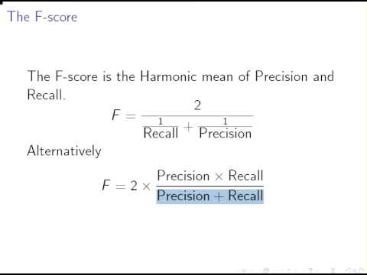
F1-SCORE

Slide 114
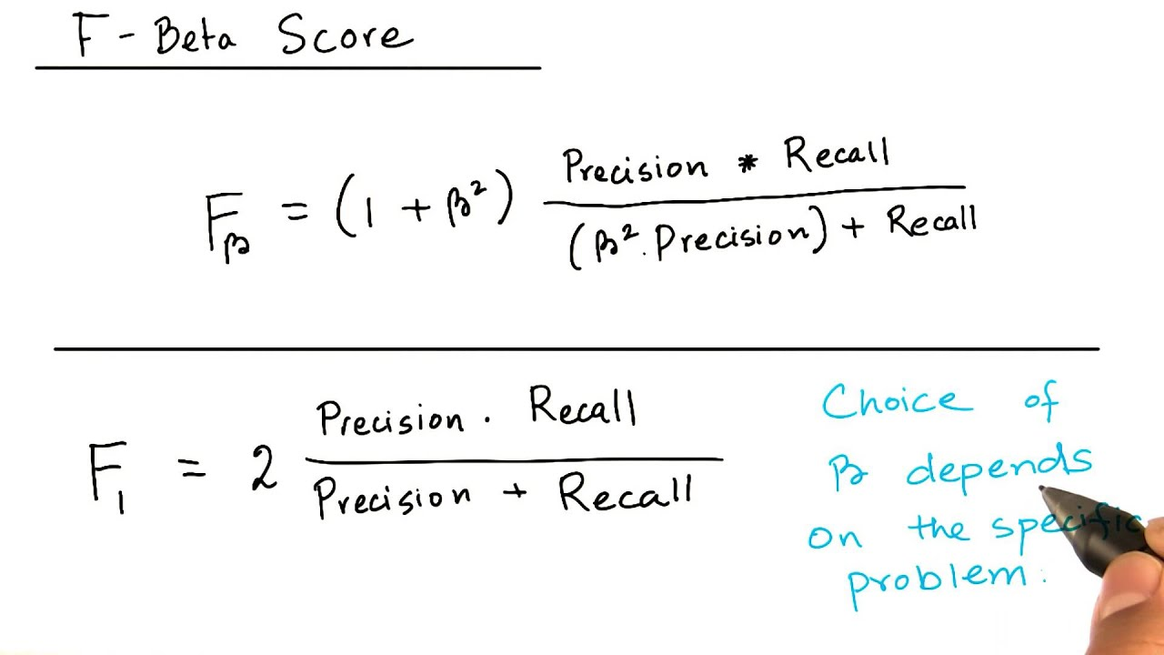

Slide 115
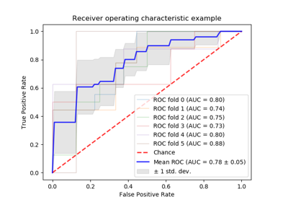
AUC

Slide 116
AUC
I've split my data into a training and test set (75% and 25% split respectively), and have subsequently performed a 5-fold cross validation on the training set using GridSearchCV in order to find the optimal hyperparameters for four different classification models (LR, RF, SVM and k-NN). I have then yielded their corresponding validation, training and testing AUC scores.
However, I am confused about which AUC score to pay attention to when it comes to describing the performance of the classifiers as well as deciding which one is the most optimal one - do I pay attention to the validation AUC score or to the test AUC score? Should it be the former case, what is the point of splitting the data into a test and training set in the first place?
There are countless examples online where data splitting is always performed, where the mean validation AUC and test AUC scores are found, and where the ROC curve is drawn for the test set, but everybody always seems to neglect the explanation of which AUC score one should focus on when choosing the optimal classification model, and most importantly, why. Does the test set act as some form of reassurance?
In my situation I obtain the following AUC scores:

Slide 117
SVM training AUC: 0.727
SVM validation AUC: 0.703
SVM test AUC: 0.762
RF training AUC: 1.000
RF validation AUC: 0.791
RF test AUC: 0.625
LR training AUC: 0.776
LR validation AUC: 0.689
LR test AUC: 0.737
k-NN training AUC: 0.895
k-NN validation AUC: 0.792
k-NN test AUC: 0.646

Slide 118


Slide 119


Slide 120


Slide 121

Step in modelling

Slide 122
Data Preprocessing
Steps Involved in Data Preprocessing:
1. Data Cleaning: The data can have many irrelevant and missing parts. To handle this part, data cleaning is done. It involves handling of missing data, noisy data etc.
(a). Missing Data: This situation arises when some data is missing in the data. It can be handled in various ways. Some of them are:Ignore the tuples: This approach is suitable only when the dataset we have is quite large and multiple values are missing within a tuple.
Fill the Missing values: There are various ways to do this task. You can choose to fill the missing values manually, by attribute mean or the most probable value.

Slide 123
(b). Noisy Data: Noisy data is a meaningless data that can’t be interpreted by machines.
It can be generated due to faulty data collection, data entry errors etc.
It can be handled in following ways :
Binning Method: This method works on sorted data in order to smooth it. The whole data is divided
into segments of equal size and then various methods are performed to complete the task.
Each segmented is handled separately.
One can replace all data in a segment by its mean or boundary values can
be used to complete the task.
Regression: Here data can be made smooth by fitting it to a regression function.
The regression used may be linear (having one independent variable)
or multiple (having multiple independent variables).
Clustering: This approach groups the similar data in a cluster.
The outliers may be undetected or it will fall outside the clusters.

Slide 124
2. Data Transformation: This step is taken in order to transform the data in appropriate forms suitable for mining process. This involves following ways:
Normalization: It is done in order to scale the data values in a specified range (-1.0 to 1.0 or 0.0 to 1.0)
Attribute Selection: In this strategy, new attributes are constructed from the given set of attributes to help the mining process.
Discretization: This is done to replace the raw values of numeric attribute by interval levels or conceptual levels.
Concept Hierarchy Generation: Here attributes are converted from level to higher level in hierarchy. For Example-The attribute “city” can be converted to “country”

Slide 125
3. Data Reduction: Since data mining is a technique that is used to handle huge amount of data. While working with huge volume of data, analysis became harder in such cases. In order to get rid of this, we uses data reduction technique. It aims to increase the storage efficiency and reduce data storage and analysis costs.
The various steps to data reduction are:
Data Cube Aggregation: Aggregation operation is applied to data for the construction of the data cube.
Attribute Subset Selection: The highly relevant attributes should be used, rest all can be discarded. For performing attribute selection, one can use level of significance and p- value of the attribute.the attribute having p-value greater than significance level can be discarded.
Numerosity Reduction: This enable to store the model of data instead of whole data, for example: Regression Models.
Dimensionality Reduction: This reduce the size of data by encoding mechanisms.It can be lossy or lossless. If after reconstruction from compressed data, original data can be retrieved, such reduction are called lossless reduction else it is called lossy reduction. The two effective methods of dimensionality reduction are:Wavelet transforms and PCA (Principal Componenet Analysis)

Slide 126
Data contain some missing value null and variable which are not relevant for
analysis. We found that these variable have 75% missing value so we can eliminate
Them from our analysis.
#values of missing variable with total no of missing value > 75% and value is > than 6,40,000.
#desc 734157
#mths_since_last_record 724785
#mths_since_last_major_derog 642830
#annual_inc_joint 855527
#dti_joint 855529
#verification_status_joint 855527
#open_acc_6m 842681
#open_il_6m 842681
#open_il_12m 842681
#open_il_24m 842681
#mths_since_rcnt_il 843035
#total_bal_il 842681
#il_util 844360
#open_rv_12m 842681
#open_rv_24m 842681
#max_bal_bc 842681
#all_util 842681
#inq_fi 842681
#total_cu_tl 842681
#inq_last_12m 842681

Slide 127
Data Cleaning:
#dropping irrelavent columns
#dropping irrelavent columns.
#After having a closer look at the data (and studying frequency tables), we can remove the following variables, reasons described:
# 1. policy_code is always == 1
# 2. payment_plan has only 10 y and 887372 n
# 3. id and member_id are all unique, which is a bit misleading. So every record is a unique customer
# 4. application_type is 'INDIVIDUAL' for 99.94% of the records
# 5. acc_now_delinq is 0 for 99.5% of the records
# 6. emp_title not needed here, but it might be useful for the modelling (see below),
# 7. zip_code not needed for this level of analysis,
# 8. title can be removed as well.
# 9. adder_stat can be remove to.
dataset=dataset.drop(["id","member_id",'addr_state',"emp_title","member_id","pymnt_plan","title","zip_code",
"earliest_cr_line","out_prncp","total_rec_prncp","total_rec_int","recoveries",
"collection_recovery_fee","last_pymnt_d","last_pymnt_amnt","next_pymnt_d",
"last_credit_pull_d","collections_12_mths_ex_med","policy_code","application_type",
"acc_now_delinq","tot_coll_amt"],axis=1)
dataset.isnull().sum()

Slide 128

Exploratory data analysis
In statistics, exploratory data analysis (EDA) is an approach to analyzing data sets to summarize their main characteristics, often with visual methods. A statistical model can be used or not, but primarily EDA is for seeing what the data can tell us beyond the formal modeling or hypothesis testing task. Exploratory data analysis.
There are a number of tools that are useful for EDA, but EDA is characterized more by the attitude taken than by particular techniques.^{[7]}
Typical graphical techniques used in EDA are:
Box plot
Histogram
Multi-vari chart
Run chart
Pareto chart
Scatter plot
Stem-and-leaf plot
Parallel coordinates
Odds ratio

Slide 129
Targeted projection pursuit
Glyph-based visualization methods such as PhenoPlot^{[8]} and Chernoff faces
Dimensionality reduction:
Multidimensional scaling
Principal component analysis (PCA)
Multilinear PCA
Nonlinear dimensionality reduction (NLDR)
Projection methods such as grand tour, guided tour and manual tour
Interactive versions of these plots
Typical quantitative techniques are:
Median polish
Trimean
Ordination

Slide 130



#distribution of Dependent Variable
#dataset['default_ind'].value_counts().plot.bar()
65,996
#Loan Purpose
#Debt Consolidation stands as clear winner for loan purpose, with more than 350K loans — or 58% from the total.
7,89,973

Slide 131




5,98,976
2,56,993
7,89,973
65,996

Slide 132




Avg threshold = 12.5%

Slide 133




#Distribution of dependent variable

Slide 134
Feature engineering
Feature engineering is the process of using domain knowledge of the data to create features
that make machine learning algorithms work. Feature engineering is fundamental to the
application of machine learning, and is both difficult and expensive.
The need for manual feature engineering can be obviated by automated feature learning.
Feature engineering is an informal topic, but it is considered essential in applied machine learning.
Coming up with features is difficult, time-consuming, requires expert knowledge.
"Applied machine learning" is basically feature engineering.
— Andrew Ng, Machine Learning and AI via Brain simulations.

Slide 135
A feature is an attribute or property shared by all of the independent units on which analysis or prediction is to be done. Any attribute could be a feature, as long as it is useful to the model.
The purpose of a feature, other than being an attribute, would be much easier to understand in the context of a problem. A feature is a characteristic that might help when solving the problem.
The process of feature engineering
:
Brainstorming or Testing features;
Deciding what features to create;
Creating features;
Checking how the features work with your model;
Improving your features if needed;
Go back to brainstorming/creating more features until the work is done.

Slide 136
Data wrangling,
sometimes referred to as data munging, is the process of transforming and mapping data from one "raw" data form into another format with the intent of making it more appropriate and valuable for a variety of downstream purposes such as analytics. A data wrangler is a person who performs these transformation operations.
This may include further munging, data visualization, data aggregation, training a statistical model, as well as many other potential uses. Data munging as a process typically follows a set of general steps which begin with extracting the data in a raw form from the data source, "munging" the raw data using algorithms (e.g. sorting) or parsing the data into predefined data structures, and finally depositing the resulting content into a data sink for storage and future use

Slide 137


Slide 138
Regression
Regression is an statistical tool which is used to estimate relation between dependent and independent
Variable.
Y=ẞ0 +ẞ1X+E
Data points –Linear relationship
Y-Dependent
In-Dependent(X)

Slide 139
Assumptions
The Residuals have a normal distribution for respective dependent variable values.
The sum of residuals is always zero ideally the expected value of the residual at respective value of Y is Zero.
For respective independent variable value the residual variance is homogenous and is independent of the Y variable.
There should be no Auto-Correlation Between residuals.
All independent variable are uncorrelated in terms of error.
The mean of error terms should be zero.
No Multi-collinearity.
No-Hetroscedasticity.

Slide 140


Hetroscedasticity.

Slide 141


Slide 142


Slide 143


Slide 144
Modelling Using Machine Learning
Data
TEST
Model Formation
TRAIN
Data Cleaning
Validate Model

Slide 145


Slide 146
Supervised Learning
Linear Regression
Predict the value of a dependent variable based on the value of at least
One independent variable.
Explain the impact of change in an independent variable on the dependent
variable
Simple Linear Regression Model
Only one Independent variable x
Relationship between x and y is described by the linear function
Change in y are assumed to be caused by changes in x.

Slide 147
Types of linear Relationship
No Linear Relationship
Positive Linear Relationship
Negative Linear Relationship
NO Relationship

Slide 148
Sample Data for House Price Model
House price in $1000s(y) | Squre feet(x)
245 | 1400
312 | 1600
279 | 1700
308 | 1875
199 | 1100
219 | 1550
405 | 2350
324 | 2450
319 | 1425
255 | 1700

Slide 149
SUMMARY OUTPUT
Regression Statistics
Multiple R | 0.762114
R Square | 0.580817
Adjusted R Square | 0.528419
Standard Error | 41.33032
Observations | 10
ANOVA
 | df | SS | MS | F | Significance F
Regression | 1 | 18934.93 | 18934.93 | 11.08476 | 0.010394
Residual | 8 | 13665.57 | 1708.196
Total | 9 | 32600.5
 | Coefficients | Standard Error | t Stat | P-value | Lower 95% | Upper 95% | Lower 95.0% | Upper 95.0%
Intercept | 98.24833 | 58.03348 | 1.69296 | 0.128919 | -35.5771 | 232.0738 | -35.5771 | 232.0738
X Variable 1 | 0.109768 | 0.032969 | 3.329378 | 0.010394 | 0.03374 | 0.185795 | 0.03374 | 0.185795

Slide 150


Slide 151
KNN- K NEAREST NEIGHBOUR
It is instance based and lazy learning.
Use when we have little or Prior knowledge about the distribution
of the data.
Highly effective inductive inference method for noisy training data and
Complex target function.
K in KNN is number of nearest neighbour

Slide 152
K-Nearest Neighbour is a simple algorithm
That stores all available cases and
Predict the target based on a similarity
measure
X1
X2

Slide 153


Slide 154


Slide 155


Slide 156
APPLICATION
TEXT MINING , AGRICULTURE, FINANCE, STOCK CURRENCY EXCHANGE RATE FINANCE RISK
In example of a typical computer vision computation pipeline for face recognition
using k-NN including feature extraction and dimension reduction pre-processing steps (usually implemented with OpenCV):
Haar face detection
Mean-shift tracking analysis
PCA or Fisher LDA projection into feature space, followed by k-NN classification

Slide 157
Feature extraction
When the input data to an algorithm is too large to be processed and it is suspected to be redundant (e.g. the same measurement in both feet and meters) then the input data will be transformed into a reduce.
Representation set of features (also named features vector).
Transforming the input data into the set of features is called feature extraction. If the features extracted are carefully chosen it is expected that the features set will extract the relevant information from the input data in order to perform the desired task using this reduced representation instead of the full size input. Feature extraction is performed on raw data prior to applying k-NN algorithm on the transformed data in feature space.

Slide 158

Unsupervised learning
is a term used for Hebbian learning, associated to learning without a teacher, also known as self-organization and a method of modelling the probability density of inputs.

Slide 159


Slide 160


Slide 161


Slide 162


Slide 163
CLUSTERING
Cluster analysis or clustering is the task of grouping a set of objects in such a way that objects in the same group (called a cluster) are more similar (in some sense) to each other than to those in other groups (clusters). It is a main task of exploratory data mining, and a common technique for statistical data analysis, used in many fields, including machine learning, pattern recognition, image analysis, information retrieval, bioinformatics, data compression, and computer graphics.
The notion of a "cluster" cannot be precisely defined, which is one of the reasons why there are so many clustering algorithms. There is a common denominator: a group of data objects. However, different researchers employ different cluster models, and for each of these cluster models again different algorithms can be given. The notion of a cluster, as found by different algorithms, varies significantly in its properties. Understanding these "cluster models" is key to understanding the differences between the various algorithms.

Slide 164
CLUSTERING
K-MEAN
HIERARCHICAL
C-MEAN

Slide 165

K-MEAN
It is also called exclusive clustering , hard clustering data point belongs exclusively to one cluster.

Slide 166


Slide 167


Slide 168
C-MEAN
It is also called Fuzzy- clustering , data point belongs multiple cluster.
multiple cluster.

Slide 169
HIERARCHICAL
In such type of clustering we usually develop Relation
country
state
Relation Development
District

Slide 170


Slide 171
ECULIDEAN DISTANVE

Slide 172
REDUCTION IN VARIANCE
K
CLUSTER INCREASE

Slide 173
SVM
It's a popular supervised learning algorithm (i.e. classify or predict target variable). It works both for classification and regression problems. It's one of the sought-after machine learning algorithm that is widely used in data science competitions.

Slide 174
What is Support Vector Machine?
The main idea of support vector machine is to find the optimal hyperplane (line in 2D, plane in 3D and hyperplane in more than 3 dimensions) which maximizes the margin between two classes. In this case, two classes are red and blue balls. In layman's term, it is finding the optimal separating boundary to separate two classes (events and non-events).
SUPPORTING VECTORS
MARGIN
OPTIMAL
HYPER-PLANE

Slide 175
Support Vectors are observations that supports hyperplane on either sides. In the image above, filled red and yellow triangle and circles are support vectors.
Why Hyperplane?
Hyperplane is just a line in 2D and plane in 3D. In higher dimensions (more than 3D), it's called hyperplane. SVM help us to find a hyperplane (or separating boundary) that can separate two classes (red and blue dots).

Slide 176
What is Margin?
It is the distance between the hyperplane and the closest data point. If we double it, it would be equal to the margin.
Objective : Maximize the margin between two categories
How to find the optimal hyperplane?
In your dataset, select two hyperplanes which separate the data with no points between them and maximize the distance between these two hyperplanes. The distance here is 'margin’.
How to treat Non-linear Separable Data?
Imagine a case - if there is no straight line (or hyperplane) which can separate two classes? In the image shown below, there is a circle in 2D with red and blue data points all over it such that adjacent data points are of different colors.

Slide 177
SVM: NONLINEAR SEPARABLE DATA

Slide 178
SVM handles the above case by using a kernel function to handle non-linear separable data. It is explained in the next section.
What is Kernel?
In simple words, it is a method to make SVM run in case of non-linear separable data points. The kernel function transforms the data into a higher dimensional feature space to make it possible to perform the linear separation. See the image below

Slide 179
Z2
X2
X1
Z1
Z3
: (X1,X2)---------------((X1*X1), SQRT(2X1X2), (X2*X2))

Slide 180
In this case, we have transformed our data into a 3 dimensional space. Now data points are separated by a simple plane. It is possible by kernel function. We can say a nonlinear function is learned by a support vector (linear learning) machine in a high-dimensional feature space.
Different Kernels
1. linear: u'*v
2. polynomial: (gamma*u'*v + coef0)^degree
3. radial basis (RBF) : exp(-gamma*|u-v|^2)
4. sigmoid : tanh(gamma*u'*v + coef0)
RBF is generally the most popular one.

Slide 181
How SVM works?
1. Choose an optimal hyperplane which maximize margin
2. Applies penalty for misclassification (cost 'c' tuning parameter).
3. If non-linearly separable data points, transform data to high dimensional space where it is easier to classify with linear decision surfaces (Kernel trick)
Advantages of SVM
1. SVM performs well in case of non-linear separable data using kernel trick.
2. It works well in high dimensional space (i.e. large number of predictors)
3. It works well in case of text or image classification.
4. It does not suffer multicollinearity problem

Slide 182
Disadvantages of SVM
1. It takes a lot of time on large sized data sets
2. It does not directly return probability estimates.
3. The linear kernel is almost similar to logistic regression in case of linear separable data.

Slide 183
Support Vector Machine - Regression
Yes, Support Vector Machine can also be used for regression problem wherein dependent or target variable is continuous.
The goal of SVM regression is same as classification problem i.e. to find maximum margin. Here, it means minimize error. In the case of regression, a margin of tolerance (epsilon) is set in approximation to the SVM. The primary goal is to minimize error, individualizing the hyperplane which maximizes the margin, keeping in mind that part of the error is tolerated.

Slide 184
SVM – Standardization
All kernel methods are based on distance. Hence, it is required to scale our variables. If we do not standardize our variables to comparable ranges, the variable with the largest range will completely dominate in the computation of the kernel matrix. For example, we have two variables - X1 and X2. Values of variable X1 lies between 0 and 100 whereas values of X2 lies in range of 100 and 10000. In this case, variable X2 would dominate variable X1. It is recommended to standardize each variables to the range [-1.1] or [0,1]. The z-score and min-max are the two popular methods to standardize variables. Another reason of standardization is to avoid numerical difficulties during computation. Because kernel values usually depend on the inner products of feature vectors, e.g. the linear kernel and the polynomial kernel, large attribute values might cause numerical

Slide 185
Tuning Parameters of SVM
If Linear Kernel SVM
There is only one parameter in linear kernel - Cost (C). It implies misclassification cost on training data.
1. A large C gives you low bias and high variance. Low bias because you penalize the cost of misclassification a lot. Large C makes the cost of misclassification high, thus forcing the algorithm to explain the input data stricter and potentially overfit.
2. A small C gives you higher bias and lower variance. Small C makes the cost of misclassification low, thus allowing more of them for the sake of wider "cushion" .

Slide 186
The goal is to find the balance between "not too strict" and "not too loose". Cross-validation and resampling, along with grid search, are good ways to finding the best C.

Slide 187
If Non-Linear Kernel (Radial)
Two parameters for fine tuning in radial kernel - Cost and Gamma
The parameter cost is already explained above (See the 'Linear Kernel' section).
Gamma explains how far the influence of a single training example reaches. When gamma is very small, the model is too constrained and cannot capture the complexity or “shape” of the data.
R : Grid Search
cost=10^(-1:2), gamma=c(.5, 1, 2)

Slide 188
Polynomial kernel Tuning Parameters:
1. degree (Polynomial Degree)
2. scale (Scale)
3. C (Cost)
Support Vector Regression Tuning Parameters:
1. Epsilon (e)
2. Cost (c)

